Slide 1
Runtime Monitors to Enforce the Physical Semantics of Code
Andrew Elsey
Advisors: Kevin Sullivan, Sebastian Elbaum
Notes:
Hi I’m Andrew, and I’m going to quickly give you an overview of my current research.

Slide 2

Motivation
What happened?
1999 Mars Climate Orbiter
NASA JPL and Lockheed
Burned up in atmosphere
$125M project
Why did this happen?
Ft-lb sec vs newton sec
Physically meaningless result
Dimensional inconsistency
Notes:
In 1999, NASA commissioned and launched a mission to Mars via a space probe called the Mars Climate Orbiter. NASA JPL, in conjunction with Lockheed Martin built the software for this probe. Unbeknownst to NASA, Lockheed Martin did not implement its software specification to the letter. The result of a computation was returned in foot-pound seconds, in the Imperial System, instead of the promised newton-seconds, which is in the metric system. As a result, the orbiter’s impulse calculations were off by an order of magnitude, and the orbiter burned up in Mar’s atmosphere. In turn, many careers were damaged and a hundred twenty five million dollar investment was lost.
The key mistake is that NASA performed a computation that expected some of its input to be in different units. As it was not, the calculation was physically meaningless. We call this an example of a dimensional inconsistency.

Slide 3
Dimensionally inconsistent code
float apples = 7;
float oranges = 8; bool x = apples > oranges;
Code is overly abstracted from real world meaning
Physically meaningless computations go undetected
Notes:
Some of that may not have made complete sense, so let’s move to a very simple example using pseudo-C++.
Here we define two float variables. C++ allows us to specify their static types as floating point numbers, but we can see that these represent the real world types of apples and oranges. Next, we try to compare those variables. C++ allows us to do that, but we humans know that this doesn’t make any real world sense. You can’t compare apples and oranges.
We say that this code abstracts away its real world meaning. In actual software systems, this is commonly the way people write code. Resultantly, these physically meaningless computations can go undetected and trigger unexpected behavior.

Slide 4
Dimensionally Inconsistent Robotics Code
[Elbaum et al. ….]
Notes:
If you’re wondering if this is a real issue in actual CPS systems, here are a few examples out of thousands in actual robotics systems. These were found in public ROS projects, using a system called Phriky Units which can detect limited dimensional inconsistencies in code.
In the first example, on the left side, the expression reduces to units in meters squared. On the right side, the expression reduces to meters. This is a physically meaningless comparison.
In the second example, on the left side, we have a calculation in velocity, whereas on the right side, we have a calculation in acceleration. Again this is physically meaningless.

Slide 5
Existing Work
Notable prior results
Osprey [Su et al., 2006]
Real World Type System [Xiang et al., 2015)
Phriky Units (Ore et al., 2017)
Phys (Kate et al., 2018)
Peirce (Leung & Sullivan, 2019)
Shortcoming
Mostly limited to simple units
Based on static analysis, limited to statically checkable constraints
Range bounds, transformation domain constraints, etc.
Notes:
There have been many attempts to fix this problem in recent history. Although I won’t go through each of these, the prevailing theme amongst these works is that they’re limited to detecting simple unit inconsistencies, for example, between velocity variables and acceleration variables, and they’re all limited to enforcing statically checkable constraints. Many constraints, such as checking that a variable falls within some specified range, or that a transformation specifically represents a rotation as opposed to a skew or shear, cannot, in almost all cases, be proven statically.

Slide 6
Approach
Statically annotate code with intended physical interpretations
float angle; // @{ f | 0 <= f < 360 }
float a; ; // @apples
float o; // @oranges
x = a > o // !! error, statically enforceable
angle = f(p, q) // !! hard to enforce statically
Weave dynamic constraint checking code, derived from static annotations, into base program to detect (and eventually enforce) physical constraints dynamically
We believe this is a hard and interesting problem
Notes:
The approach that we’re proposing is to detect (and eventually enforce) these constraints that are often infeasible statically, at runtime.
We’ll do that by statically annotating code with these physical interpretations.
For example, for a variable named angle, we can directly annotate it a range bound. Or, we might label this variable as an angle in degrees, and a range bound can be derived automatically. We can also label variables with their physical units, such as apples and oranges, and attempt to verify that these units are in fact true at runtime. Again, it’s fairly easy to detect that apples can’t be compared to oranges statically. However, in the last line, it is nearly impossible for modern computers to prove that the angle variable has a valid angle at runtime following its assignment. Intuitively, we’re usually not sure what the results of the function call expression f is.
In cases like this, we want to weave in dynamic constraint checking code into the original codebase. These constraints derive from the static annotations, with the purpose of detecting if there is any sort of dimensional inconsistency.
We believe this a highly non-trivial and novel formulation which can advance the prior state of the art if successful.

Slide 7
Evaluation
Implement proposed method on top of our Clang/LLVM infrastructure
Select a small corpus of exemplary robotics systems in ROS C++
Determine whether we find unknown dimensional inconsistencies?
Notes:
We’re going to evaluate our hypothesis by building these runtime constraints in a Clang/LLVM-based implementation
We’re using a selected set of robotics projects to annotate the code with physical meaning and constraints, we’ll inject these into the codebase, and then we’ll test to see if any constraints are violated at runtime.
Our success criterion is whether our solution is capable of detecting previously unknown or uncheckable dimensional inconsistencies at runtime.

Slide 8
Thank you!
Questions? ae8rh@virginia.edu
Notes:
Thank you everyone for listening. Please shoot me an email if you are interested or if you have any questions that I don’t have time to address. Please feel free to ask any quick questions now.

Slide 9
Challenges
Formalize relevant physical constraints using type theory
Annotating code is hard and error-prone
May need extend the state of the base program
And many more

Slide 10
Runtime Monitors
Validate CPS systems at runtime.
We can make hypotheses about CPS code statically, but we cannot prove them
How will we do it?
Assign/detect/label units at statically
Example: Velocity, “origin” of vectors (for example, a time origin can be 1/1/2000)
Generate constraints based on assigned types
Example: Angles might be within a two pi span
Inject a Reference Monitor into the source code
Compile everything
Detect constraint violations as the software runs
A physics error in the code is strongly implied

Slide 11
Research Goal and Next Steps
Using our Runtime Monitor,
What errors can we detect at runtime that would go undetected statically?
Can we show that “assumptions” in the code are incorrect? (origins, frames in ROS)
Test our hypothesis using a large ROS corpus
If successful, many ways to extend
Error handling
Static code correction
Runtime code correction

Slide 12
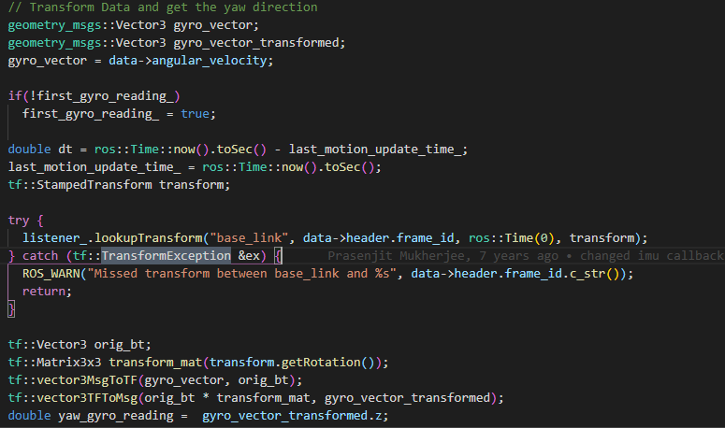
Bad Code
ROS (Robot framework)
Gyro_vector
Which frame is it in?
Base link?
What if it’s not?

